Slide 1
Benchmarking in R
how to check and compare speed of code execution?
Time efficiency

Slide 2
Benchmarking
Comparing different ways of solving the same problem
Same problem can be solved in different ways. Some are more time efficient some are slower.
We need to identify which part of the program slows down our program/code
We will discuss also byte coding
In each body of the function there is information about vytes

Slide 3
Structure of the class
system.time() –measure the time needed for execution of the code. Returns three numbers.
Benchmark() – relative time of our codes, comparison of time of codes across different option
Microbenchmark() - repeating code and see the distribution of time
Byte compiler - 0101010101001
Profiling profvis()– identifying which element of our code are the slowest

Slide 4
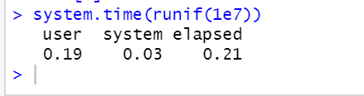
Sys.time()
Shows time in seconds
User – how long it took to generate the random numbers for the user
System – time needed for memory allocation or disk access
Elapse - sum of user and system
Due to rounding to decimal place might not be seen as the sum.
We see that it tool less than half of the second
It may happen that user>elapsed → parrarel on several course programming

Slide 5
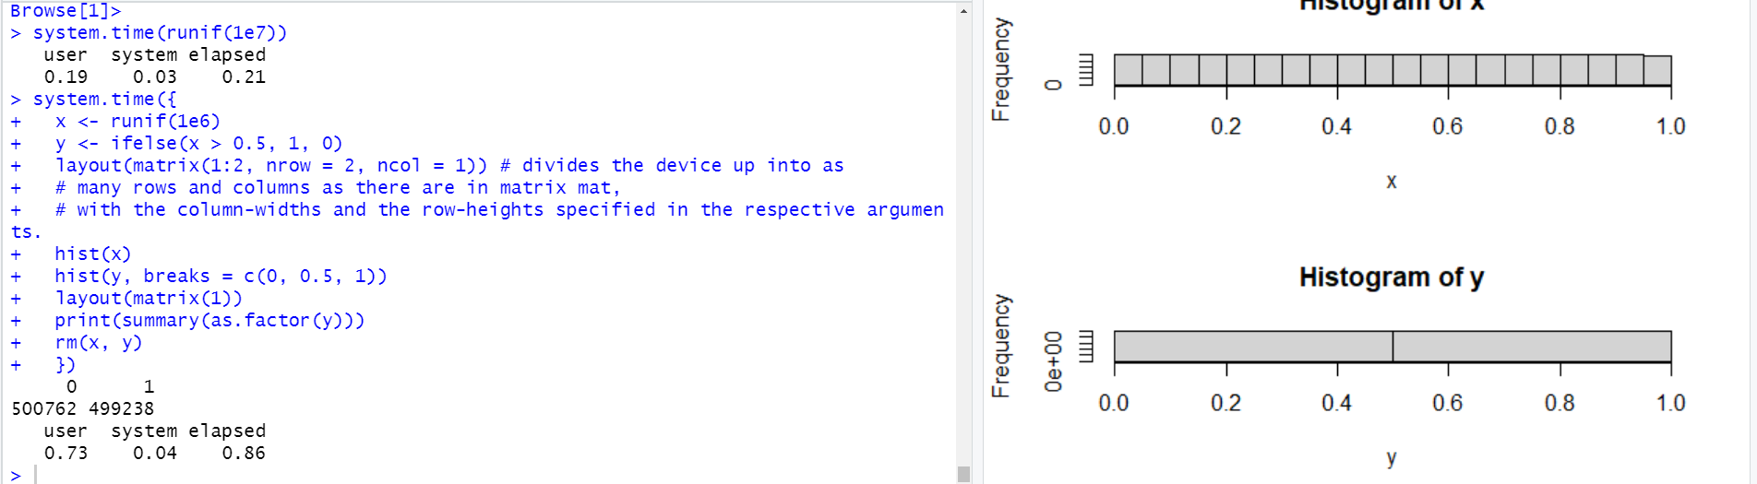
Speed of execution of longer code with sys.time → use {}

Slide 6
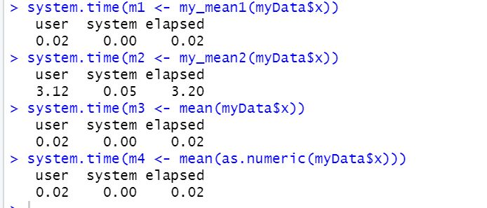
Which function is more time efficienct with sys.time?
We create several functions to calculate mean
my_mean1 function is vectorized. Sum of all vectors elements / length of vector
my_mean2 – we have loop over elements of vector. We loop over the element of vector . At each iteration we increase the value of sum. Looopover every single element of a vector
Dataframe complex object. Transformation of dataframe to vector is time consuming
Loop is the slowest. It takes almost 3 seconds

Slide 7
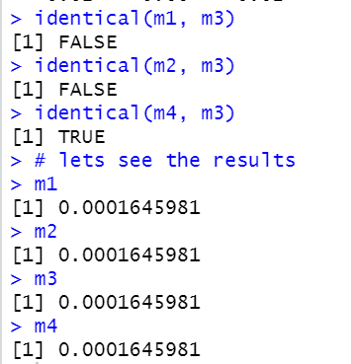
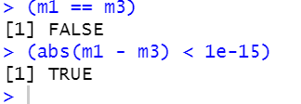
Are the result identical?
Are the result identical?
Up to 10 decimal place mean is the same for all functions.
Due to rounding it may seem that there is no difference
Our functions build in mean() is written in C++ our user defined functions written in R → each programming language different rounding policy across programming languages.
Do we care that they are not indendtical?
Function compiled from different programming languages might give us different precision after the comma.
Do we care? Yes if we work for cern

Slide 8
Benchmarking – average time needed to execute the code
Can we trust sys.time?
Benchmarking – average time needed to execute the code
We run our code 100 times and then we verify the average time of execution.
We compare codes that return the same outcome.

Slide 9
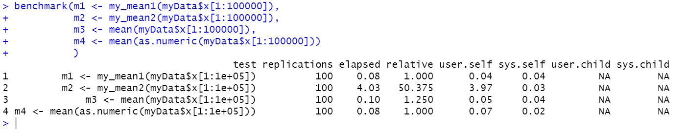
Benchmark() – how to read the output?
Says which code. It can be a label
Not useful always NA. Derived processes
We limit ourseves to 100000 elements in order not to wait too long
How much time we run it?
Time in seconds
Total time executing 100 repetitions of a particular code
Loop took 4 seconds to run 100 times
Vectorized
1 – fastest code
4.03/0.08 = 50.375 – the slowest code loop .
Using loop was 50 times slower than
the fastest approach.
0.1/0.08= 1.25
Writing own function faster than base mean() it is strange. Base mean() is more complex than our function.
Divide the number needed for 100 replications by the fastest time
Time for memory allocation
Time by user

Slide 10
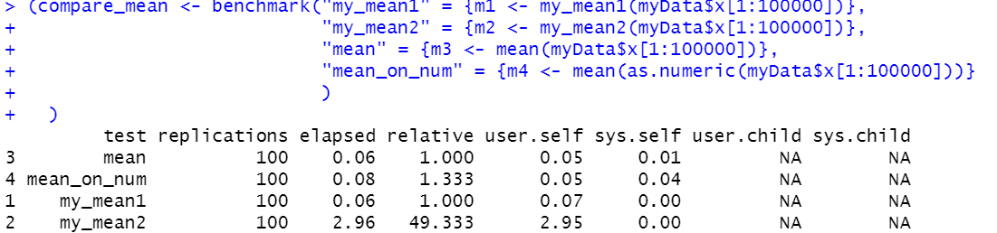

Slide 11
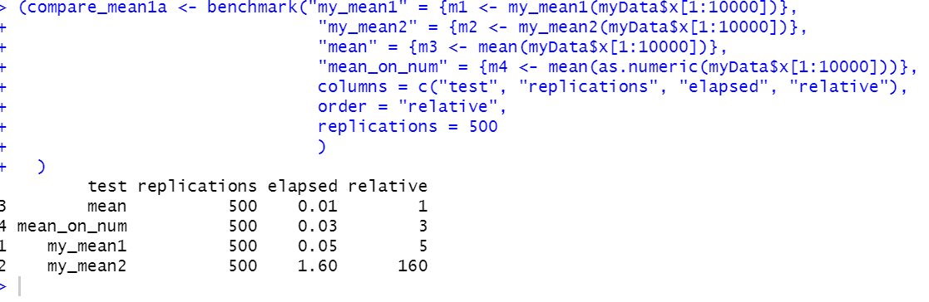
Arguments of benchmark
1. we can decide which column to print
2. Which column to sort result
3. change the repetitions – more replication more precision
Loop
Loop 160 slower than other options

Slide 12
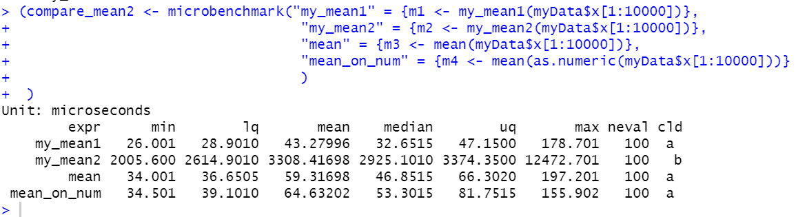
Microbenchmark() – not in seconds
Adjust the time units automatically
Distribution of time needed to run the particular code
Min time of execution
Max time of execution
Lq – lower quintile in 25 % of executing time of execution was not higher than …
Up – upper quartile only 25% of execution took longer than …
Neval - time of execution
Cld - statistical differences across different codes. Multicomparable tests. Same letters – no statisticall difference across codes. Different letters – statistical differences in terms of time execution.

Slide 13
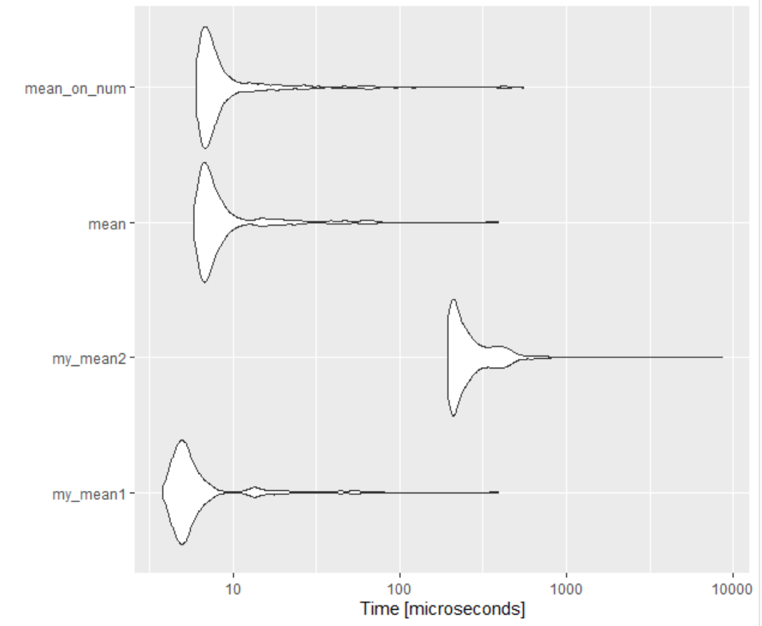
Microbenchmark() – graphical analysis
Violin plot (require ggplot)
Horizontal xaxis – time
Yaxis – our functions
Frequence of our data
My_mean1 – most frequent time the bulb in violin plot
We see the tail with max time
Main part of distribution is the bulb of violin plot
The scale is transform logarimically

Slide 14
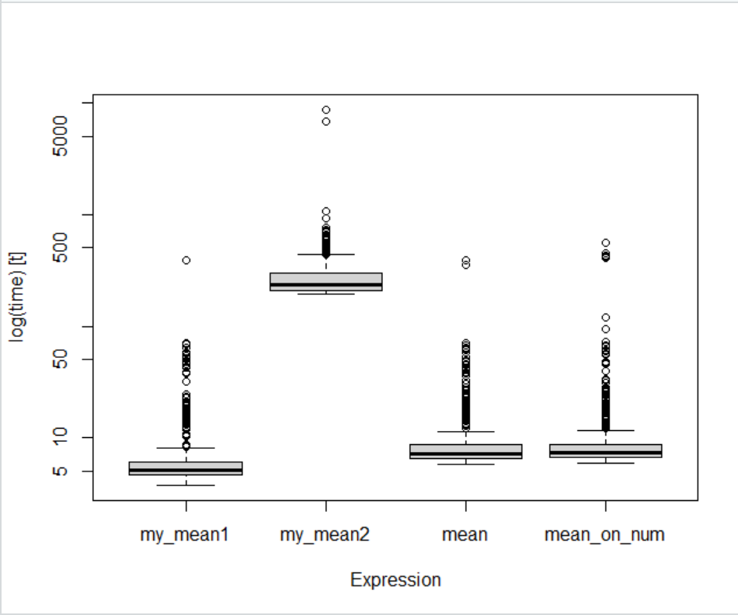
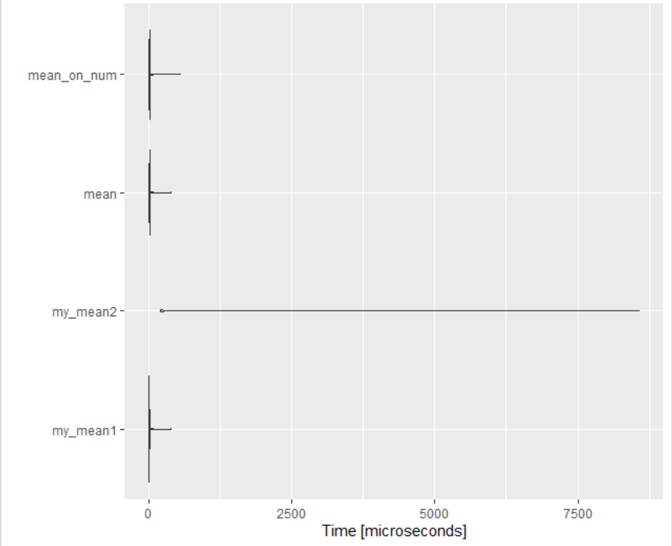
Violin plot using linear scale not visible distribution of violin plot
Boxplot for microbenchmark similar as violin
Suggest my_mean1 is the fastest

Slide 15
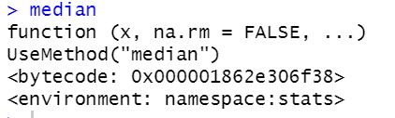
Byte compiler 42:00
Memory address
Compiling the code to byte – improve the time efficiency
Different levels of compilations
R code
High level language programming
Understood by human
Byte code
Understood by computer
Translated
Compilation to byte code. Package compiler all functions are by default are compliled when they are used for the first time
Four different levels of compilation:
0 – no translation
1 – some translation
2
3 – by default in R all functions are precompiled

Slide 16
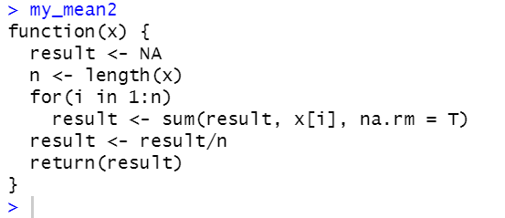
Showing how time efficiency is improved due to pre compilation
cmpfun() allows to pre-compile functions
the cmpfile() function is used to precompile the code saved in an external file
Not compiled no byte code!!!!
Newley defined
Not used yet

Slide 17
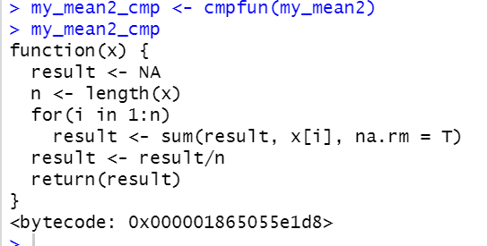
Pre compilation of function in R

Slide 18
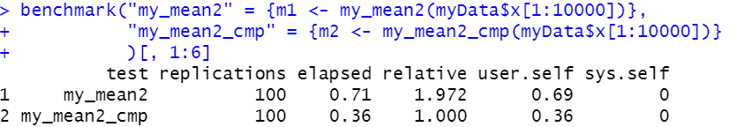
Compare the time efficiency before and after compilation
my_mean2_cmp <- cmpfun(my_mean2)
# turn off compilation
enableJIT(0)
# and compare the efficieny once again
benchmark("my_mean2" = {m1 <- my_mean2(myData$x[1:10000])},
"my_mean2_cmp" = {m2 <- my_mean2_cmp(myData$x[1:10000])}
)[, 1:6]
Function after compilation was two times faster than not compiled version of a function!!!!!

Slide 19
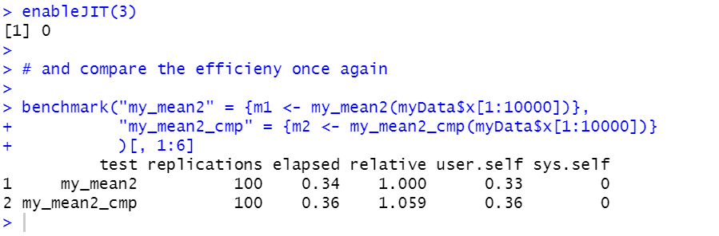
Both compiled – time is the same
My_mean2 – 1 compilation 99 already compiled !!!!

Slide 20
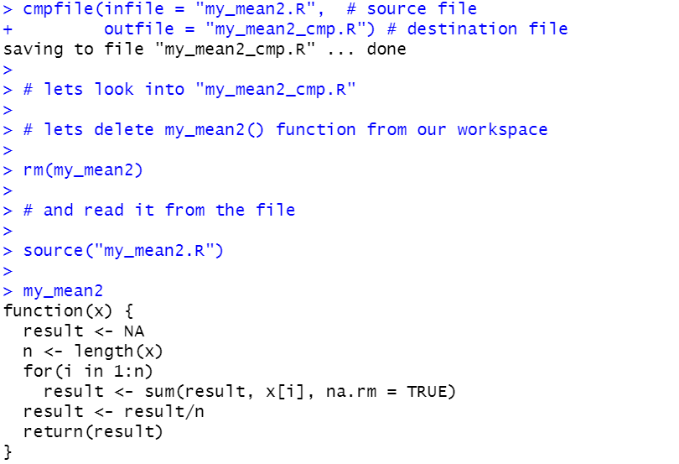
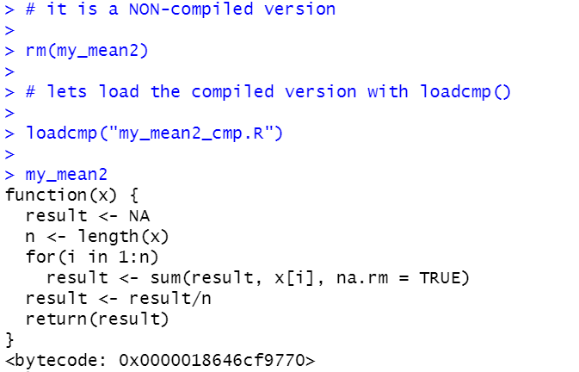
External files with function definitions and run compile them External files with function definitions and run compile them Manual compilation before we run it – we can share with our collegue the compiled files

Slide 21
Code profiling
Identify pieces of the code that slow down the code
Profvis() – graphically represents the time and memory
Argument – code that we want to profile

Slide 22
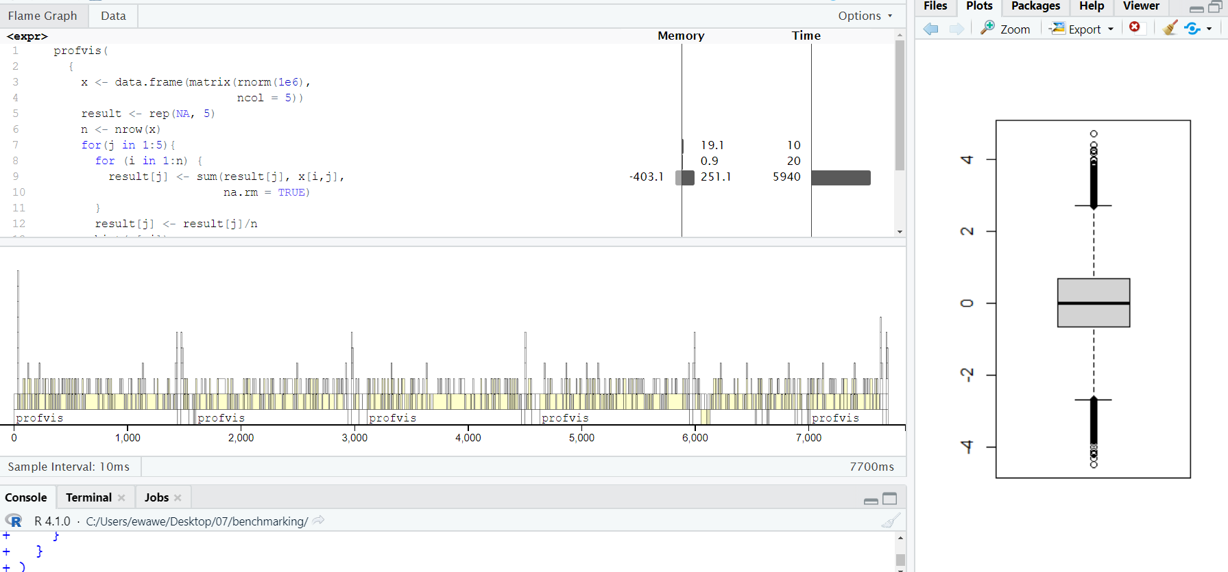
Upper panel show for each line the memory use and time efficiency. Loop took the longest
Most time spend inside the loop.
Boxplot and histogram

